Slide 1
Car Sharing App
404 Team Not Found
Cazacu Ion
Chiriac Laura-Florina

Slide 2

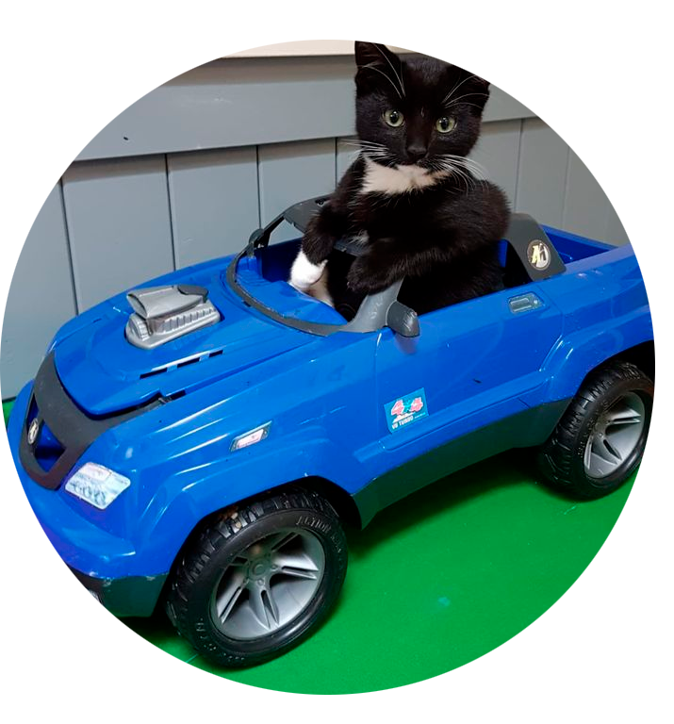
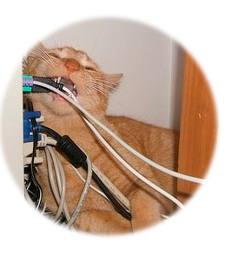

Entities
∙ 01 ∙
∙ 02 ∙
∙ 03 ∙
∙ 04 ∙
∙ 01 ∙
User
Car
Attributes: user_id, name, email, password
Responsibility: rent cars.
Attributes: vin, make, model, available, status_code
Responsibility: Represents the car available for rental.
Server
Mobile App
Responsibility: Manages communication between the client and machines, validates requests and responds to actions.
Responsibility: Graphical user interface, sends requests to the server.

Slide 3
Communication Protocol
∙ 02 ∙
Socket.IO:
Used for real-time communication between client, server and cars.
Main Events: login, query_cars, start_rental, end_rental, car_status_update
JSON:
The format of data sent between entities.
Example JSON structure for a car:
{
"vin": "VIN1234",
"make": "Toyota",
"model": "Corolla",
"available": true,
"status_code": 0
}

Slide 4
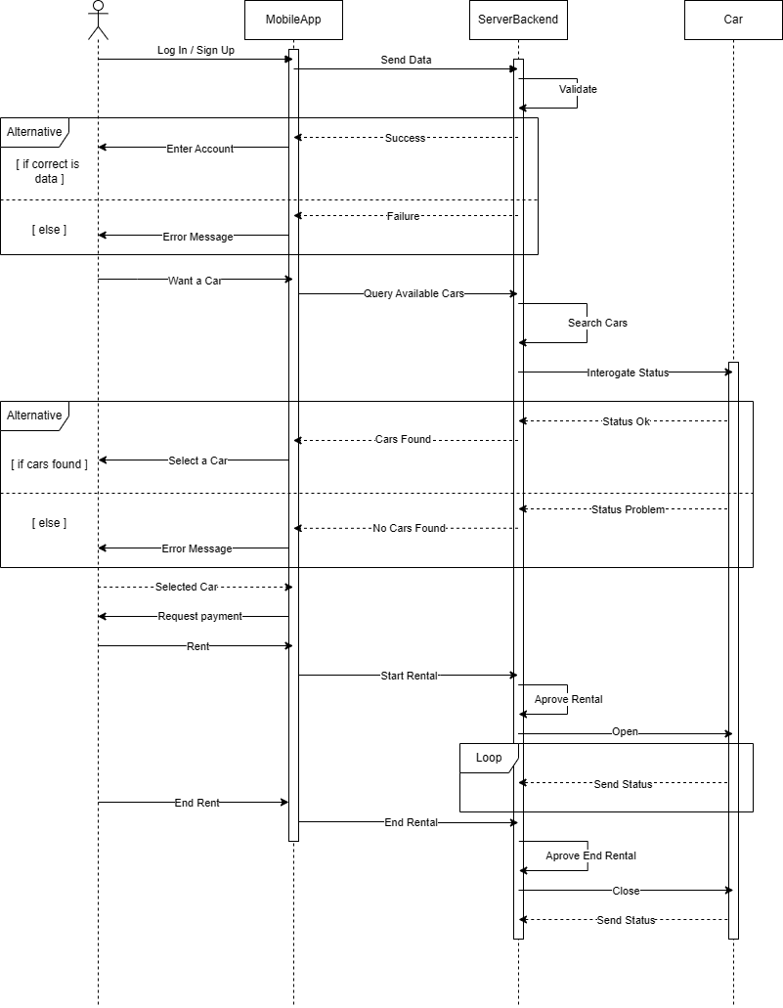
∙ 03 ∙
Flows for the use-cases

Slide 5
Authentication
Rent a Car
User enters email and password.
Client sends the request to the server.
Server validates the data and responds with success or error.
User selects an available car.
Client sends the rental request to the server.
Server checks the availability of the car and sends the confirmation.

Slide 6
Return Car
Car Status Update
User selects the car to return.
Client sends the return request to the server.
Server updates the car status and confirms the return.
Car periodically sends its status to the server.
Server notifies the client if there are any problems.

Slide 7

Technologies Used in Implementation
Programming Languages | Python
Libraries and Frameworks | Socket.IO - for real-time communication. Tkinter & Customtkinter - for the client GUI. Flask and Flask-SocketIO - for the server.
Other Technologies | JSON - for storing and transmitting data. Threading - for managing simultaneous requests.

Slide 8
∙ Thanks ∙
Your ad could be here

